Slide 1

Datatypes and Functions CSCI2141 Week 9

Slide 2
Overview
Datatypes and operations
Numeric
Text
Date/time
Casting
Finishing the Data Definition story

Slide 3

Part 1: MySQL Datatypes

Slide 4
Key Questions
How do subclasses data type of differ in:
Type of data stored?
Permitted operations?
Efficiency?
Consistency across RDBMS?
Why would I choose one over another?

Slide 5
Mega Warning
Many functions on datatypes differ by RDBMS (see Tables 7.8 – 7.13 in textbook): tread carefully!
Examples:
NUMERIC vs DECIMAL datatypes
INT types: signed vs unsigned
Nearly EVERYTHING to do with times and dates
We're going to focus on MySQL for obvious reasons; key principles are the same across RDBMSs
Reference: https://dev.mysql.com/doc/refman/8.0/en/data-types.html

Slide 6
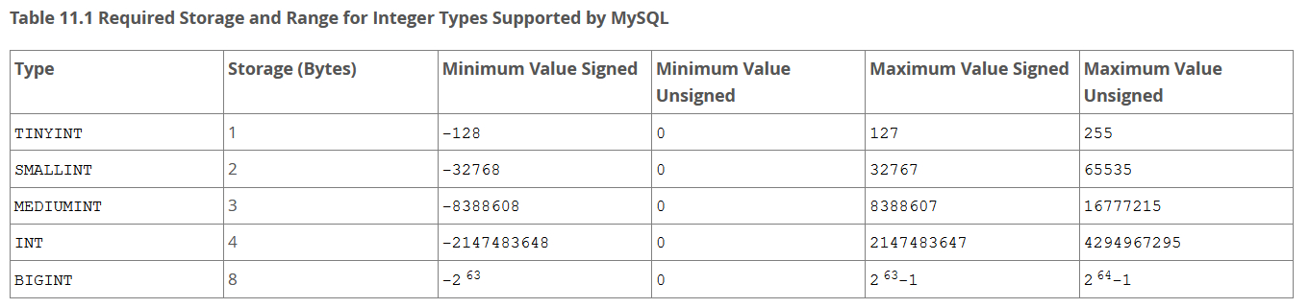
Numeric Datatypes
INT == INTEGER
https://dev.mysql.com/doc/refman/8.0/en/integer-types.html

Slide 7
Getting it Wrong: Integer Sizing
My type is too SMALL for the data:
Overflow can result
In MySQL, either an "Out of Range" error if Strict mode is on, or clipping (entries set to max for datatype)
My type is too LARGE for the data:
Greater memory usage
Slower query speeds
Wasted resources when indexing (to be discussed in late March)

Slide 8
Fixed- and Floating-Point Datatypes
Fixed-point (exact):
DECIMAL (x,y) – Maximum x digits of precision, y of which are after the decimal point
NUMERIC (x,y) is synonymous in MySQL, not in other RDBMSs
Floating-point (approximate):
FLOAT: Single precision, four bytes
DOUBLE: Double precision, eight bytes
Full of surprises!

Slide 9

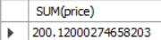
Should I use FLOAT?
-- Floating point: accurate?
CREATE TABLE prices_float (
price FLOAT
);
INSERT INTO prices_float (price) VALUES (100.05), (100.07);
SELECT SUM(price) FROM prices_float;

Slide 10
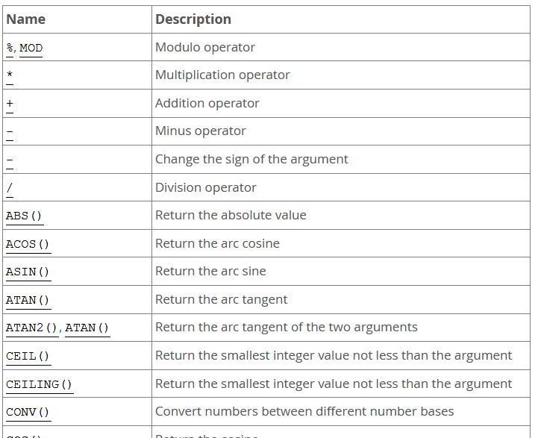
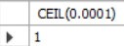
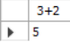
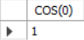
Numeric Functions
SELECT CEIL(0.0001);
SELECT 3+2;
SELECT COS(0);
https://dev.mysql.com/doc/refman/8.0/en/numeric-functions.html

Slide 11
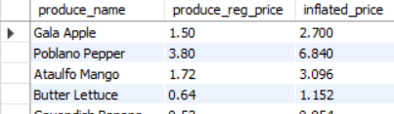
Numeric Functions: Examples
SELECT produce_name,
produce_reg_price,
produce_reg_price * 1.8 AS inflated_price
FROM produce;

Slide 12
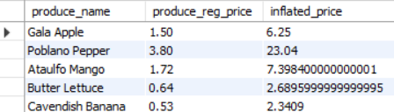

Numeric Functions: Examples
SELECT produce_name,
produce_reg_price,
POW(produce_reg_price + 1, 2) AS inflated_price
FROM produce;

Slide 13
Your Not Quite Daily Reminder
Life is full of surprises
Look at your intermediate results where possible!

Slide 14
RAND(): Random Number Between 0 and 1
-- Uses system clock, probably
SELECT RAND() AS rand1, RAND() AS rand2, RAND() AS rand3;
-- User-defined seed
SELECT RAND(555) AS rand1, RAND(555) AS rand2, RAND(555) AS rand3;

Slide 15
Character (or String) Data
CHAR(n): 1 ≤ n ≤ 255
Size is reserved and padded (so CHAR(255) is always represented with 255 characters)
VARCHAR(n): 1 ≤ n ≤ 65,535
Size is dynamically allocated based on value
TEXT:
Larger than VARCHAR, less efficient (stored externally). Cannot have DEFAULT value. TINYTEXT: max 255 characters; LONGTEXT: max 4,294,967,295

Slide 16
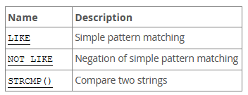
String Functions
-- Strings are identical, returns 0
SELECT STRCMP('grar','grar');
-- String1 < String2, returns -1
SELECT STRCMP('grar','grarr');
-- String1 > String2, returns 1
SELECT STRCMP('grarr','grar');

Slide 17
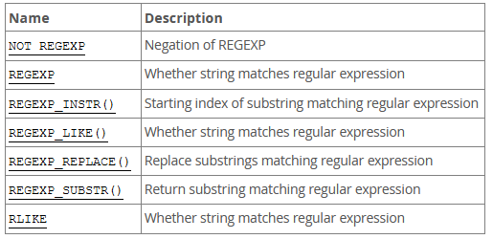
Regular Expressions!
NOT ON THE TEST, but extremely useful
(and most syntax is portable to Python, Perl, etc)

Slide 18
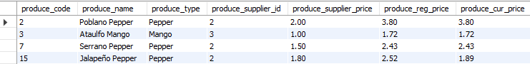
Regular Expression Examples
-- Any produce name that matches an 'o' followed by a space
-- This could also be done with LIKE '%o %'
SELECT * FROM produce WHERE produce_name REGEXP 'o ';

Slide 19
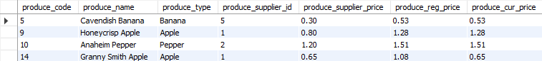
Regular Expression Examples
-- Regular expressions are case insensitive in MySQL
SELECT * FROM produce WHERE produce_name REGEXP 'h';
-- How to make them case sensitive
SELECT * FROM produce WHERE REGEXP_LIKE (produce_name ,'h','c');
https://dev.mysql.com/doc/refman/8.0/en/regexp.html

Slide 20
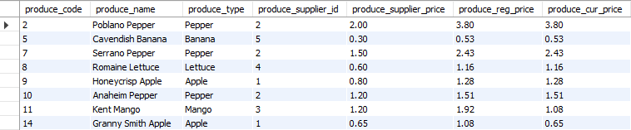
Regular Expression Examples
-- Match 1 or more consecutive occurrences of the letter 'n' in the first part of 'produce_name' (there is a space after *)
SELECT * FROM produce WHERE produce_name REGEXP 'n+.* ';
Does not match 'Ataulfo Mango'
https://dev.mysql.com/doc/refman/8.0/en/regexp.html

Slide 21
Thinking About Efficiency
Single-column table: 661,405 rows,
MIN value in column = 7
MAX value in column = 2,698,682
Memory usage:
Numeric | String
INT: 20.55 MB | VARCHAR(7): 21.55 MB
BIGINT: 23.55 MB | VARCHAR(4095): 21.55 MB
FLOAT: 20.55 MB | CHAR(7): 23.55 MB
DOUBLE: 23.55 MB | CHAR(255): 195.73 MB
 | TEXT: 21.55 MB
!!!!

Slide 22
What's Going On Here?
Numeric | String
INT: 20.55 MB | VARCHAR(7): 21.55 MB
BIGINT: 23.55 MB | VARCHAR(4095): 21.55 MB
FLOAT: 20.55 MB | CHAR(7): 23.55 MB
DOUBLE: 23.55 MB | CHAR(255): 195.73 MB
 | TEXT: 21.55 MB
The price of precision:
INT, FLOAT vs BIGINT, DOUBLE

Slide 23
What's Going On Here?
Numeric | String
INT: 20.55 MB | VARCHAR(7): 21.55 MB
BIGINT: 23.55 MB | VARCHAR(4095): 21.55 MB
FLOAT: 20.55 MB | CHAR(7): 23.55 MB
DOUBLE: 23.55 MB | CHAR(255): 195.73 MB
 | TEXT: 21.55 MB
Variable length:
VARCHAR, TEXT
Fixed length: CHAR(n)

Slide 24
Datatypes: The story so far
Numeric and string
Each has several variants that vary in:
Memory usage
Efficiency
Available functions
Precision
Now it's time for the third main class of datatypes:

Slide 25

Dates and Times

Slide 26
Dates and Times
DATE: yyyy-mm-dd
TIME: hh:mm:ss[.fraction]
'-838:59:59.000000' to '838:59:59.000000'
DATETIME: yyyy-mm-dd hh:mm:ss[.fraction]
TIMESTAMP: Like DATETIME, but:
Lesser range (1970-2038 as opposed to 1000-9999)
Different storage requirements and time-zone handling

Slide 27
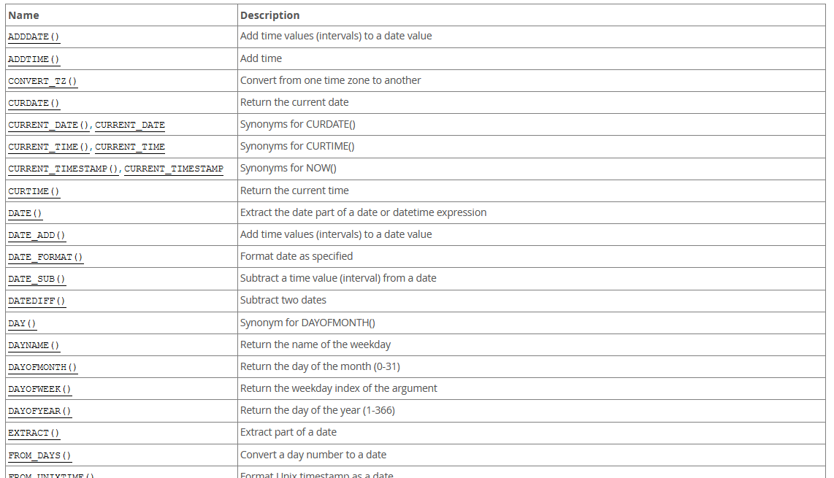
Date and Time Functions
https://dev.mysql.com/doc/refman/8.0/en/date-and-time-functions.html

Slide 28
Things to Be Careful About
11:12 is 00:11:12, not 11:12:00
Invalid values are set to 00:00:00
Time zones!
YYYY/MM/DD format is atypical relative to common usage

Slide 29
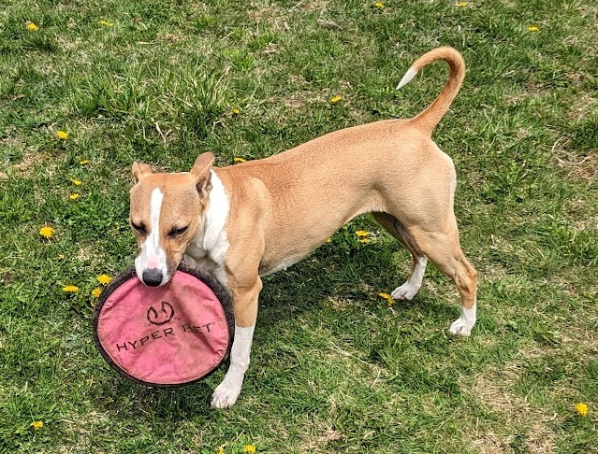
Adding Dates and Times
The Story of Mersey and Her Eyedrops
Notes:
Mersey is a dog that was bred for sports such as canine agility. She is a combination of seven breeds including Jack Russell terrier, American pit bull terrier, greyhound, and whippet. We affectionately refer to her as the “hyperintelligent sports dog”.
Mersey has an eye condition that requires us to give her eyedrops three times a day. It’s impossible for us to be completely consistent in the times we administer these, but one way to keep track would be to record values and store them in a database (this being 2141 and all). If we record them as DATETIME objects, then we can use SQL not only to store this information, we can also use functions to calculate the time interval between administrations to help us try and remain consistent.

Slide 30
Recording Dates and Times
-- Create the table to record eyedrops
CREATE TABLE eyedrops (
id INT PRIMARY KEY AUTO_INCREMENT,
eyedrop_date DATE,
eyedrop_time TIME
);
INSERT INTO eyedrops (eyedrop_date, eyedrop_time) VALUES
('2023-10-15','08:35:00'), ('2023-10-15','13:00:00'),
('2023-10-15','18:12:00'), ('2023-10-16','06:30:00'),
('2023-10-16','13:30:00'), ('2023-10-16','23:45:00');

Slide 31
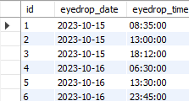
Recording Dates and Times
-- Create the table to record eyedrops
CREATE TABLE eyedrops (
id INT PRIMARY KEY AUTO_INCREMENT,
eyedrop_date DATE,
eyedrop_time TIME
);
INSERT INTO eyedrops (eyedrop_date, eyedrop_time) VALUES
('2023-10-15','08:35:00'), ('2023-10-15','13:00:00'),
('2023-10-15','18:12:00'), ('2023-10-16','06:30:00'),
('2023-10-16','13:30:00'), ('2023-10-16','23:45:00');

Slide 32
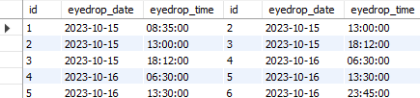
Functions on Dates and Times
-- INNER JOIN to get consecutive administrations
SELECT *
FROM eyedrops E1 INNER JOIN eyedrops E2
ON (E1.id + 1 = E2.id);

Slide 33
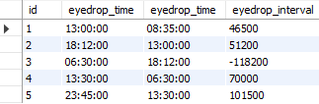
Functions on Dates and Times
-- Subtract times
SELECT E1.id, E2.eyedrop_time, E1.eyedrop_time,
(E2.eyedrop_time - E1.eyedrop_time) AS eyedrop_interval
FROM eyedrops E1 INNER JOIN eyedrops E2 ON (E1.id + 1 = E2.id);
INTEGER SUBTRACTION

Slide 34
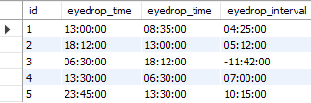

Functions on Dates and Times
-- Time difference in TIME units
SELECT E1.id, E2.eyedrop_time, E1.eyedrop_time,
TIMEDIFF(E2.eyedrop_time, E1.eyedrop_time) AS eyedrop_interval
FROM eyedrops E1 INNER JOIN eyedrops E2 ON (E1.id + 1 = E2.id);

Slide 35
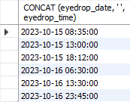
To get correct time differences, we can concatenate into a DATETIME object
-- Merge date and time
SELECT CONCAT (eyedrop_date, ' ', eyedrop_time)
FROM eyedrops;

Slide 36
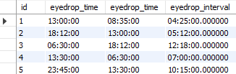
Functions on Dates and Times
-- Time difference in TIME units
SELECT E1.id, E2.eyedrop_time, E1.eyedrop_time, TIMEDIFF(CONCAT(E2.eyedrop_date, ' ', E2.eyedrop_time), CONCAT(E1.eyedrop_date, ' ', E1.eyedrop_time))
AS eyedrop_interval
FROM eyedrops E1 INNER JOIN eyedrops E2
ON (E1.id + 1 = E2.id);

Slide 37
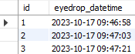
DATETIME Example
-- Whenever a row is added, include current timestamp by default
CREATE TABLE eyedrops_timestamp (
id INT PRIMARY KEY AUTO_INCREMENT,
eyedrop_datetime DATETIME DEFAULT CURRENT_TIMESTAMP
);
-- We don't need to specify anything!
INSERT INTO eyedrops_timestamp VALUES ();
INSERT INTO eyedrops_timestamp VALUES ();
INSERT INTO eyedrops_timestamp VALUES ();

Slide 38
CASTing
Convert an expression of one datatype to another datatype
CAST(expression AS datatype)
Numeric or date to CHAR(n) → no problem!
String to date or numeric → works only if format is compatible

Slide 39
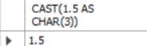
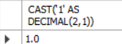
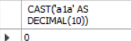
CASTing Examples
-- Floating point to char
SELECT CAST(1.5 AS CHAR(3));
-- Char(1) to decimal
SELECT CAST('1' AS DECIMAL(2,1));
-- Non-numeric char(3) to decimal
SELECT CAST('a1a' AS DECIMAL(10));

Slide 40
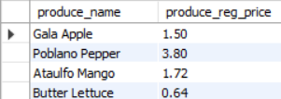
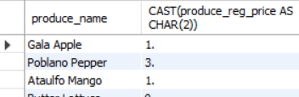
CASTing Examples
SELECT produce_name, CAST(produce_reg_price AS CHAR(2)) FROM produce;

Slide 41

Putting it together: Data Types + Data Definitions

Slide 42
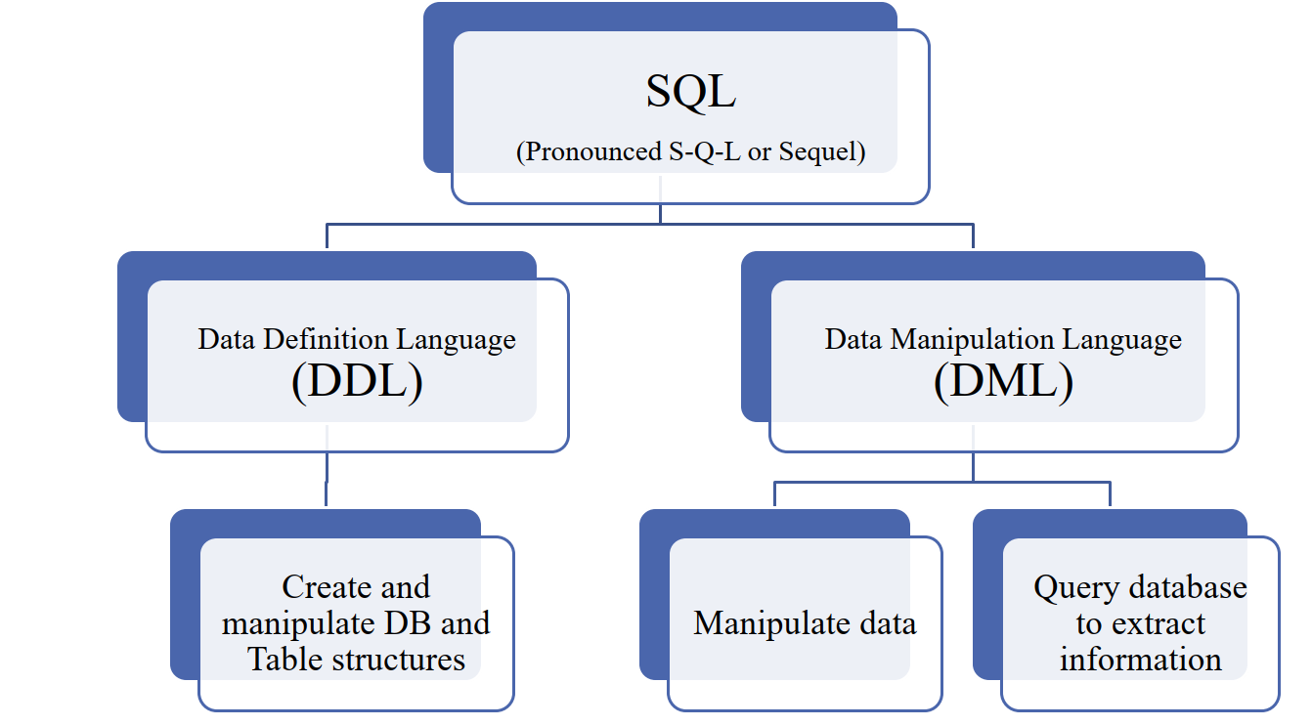
DDL– Finishing the Story

Slide 43
Reminder: Data Definition Language
DDL: "The language that allows a database administrator to define the database structure, schema, and subschema."
Schema: "A logical grouping of database objects, such as tables, indexes, views, and queries, that are related to each other."
Subschema: "The portion of the database that interacts with end-user programs."

Slide 44
Data DEFINITION
Used to create the rules for entities and attributes
What tables do we create?
What are the attribute names?
What are the attribute data types?
What are the relations?
The practical implementation of the internal database model

Slide 45
DDL Commands
CREATE
ALTER
DROP

Slide 46
CREATE TABLE
CREATE TABLE IF NOT EXISTS `tablename` (
column1 type constraints,
column2 type constraints,
…,
PRIMARY KEY (…)
FOREIGN KEY (…) REFERENCES (…)
);
Attributes
Table
constraints

Slide 47
Constraints on a Column
column1 type PRIMARY KEY,
Only works for single-attribute primary keys
(We generally define as a table-level constraint)

Slide 48
Constraints on a Column
column1 type NOT NULL,
Self-explanatory?

Slide 49
Constraints on a Column
column1 type AUTO INCREMENT,
Increments from the LARGEST VALUE,
even if smaller values are "available"

Slide 50
Constraints on a Column
column1 type DEFAULT default,
Again self-explanatory?

Slide 51
Constraints on a Column
column1 type
CHECK condition,
Restrict the allowed values for a given column

Slide 52
Constraints on a Column
column1 type
CHECK(language_family IN
('Indo-European','Afro-Asiatic','Sino-Tibetan')),
Restrict the allowed values for a given column

Slide 53
Constraints on a Column
cat_weight TINYINT
CHECK(cat_weight < 50),
Restrict the allowed values for a given column

Slide 54
Named Constraints
cat_weight INT
CONSTRAINT `impossibly_obese_cat`
CHECK(cat_weight < 50),
Makes it easier to reference the constraint later
when ALTERING a table

Slide 55
ON UPDATE (Column Action)
-- Whenever a row is added, include current timestamp by default
CREATE TABLE eyedrops_timestamp (
id INT PRIMARY KEY AUTO_INCREMENT,
eyedrop_datetime DATETIME DEFAULT CURRENT_TIMESTAMP
ON UPDATE CURRENT_TIMESTAMP
);
Update the timestamp when a value in the row is modified

Slide 56
ON UPDATE (Foreign Keys)
ON UPDATE can also be used to maintain
REFERENTIAL INTEGRITY
If T₂ has a foreign key that references the primary key of T₁
We can control what happens if a PK value in T₁ changes

Slide 57
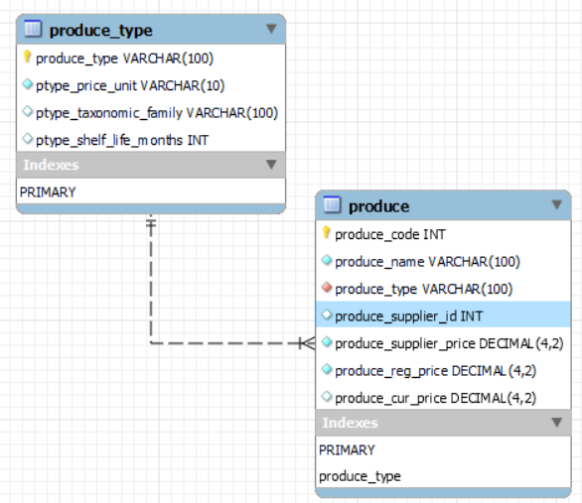
ON UPDATE - Example
CREATE TABLE produce_type (
produce_type VARCHAR(100) NOT NULL,
ptype_price_unit VARCHAR(10) NOT NULL
CONSTRAINT `produce_unit_types`
CHECK (ptype_price_unit IN ('g','kg','unit’)),
ptype_taxonomic_family VARCHAR(100),
ptype_shelf_life_months INT,
PRIMARY KEY (produce_type)
);

Slide 58
ON UPDATE - Example
CREATE TABLE produce (
produce_code INT AUTO_INCREMENT,
produce_name VARCHAR(100) NOT NULL,
produce_type VARCHAR(100) NOT NULL,
produce_supplier_id INT,
produce_supplier_price DECIMAL(4,2) NOT NULL,
produce_reg_price DECIMAL(4,2) NOT NULL,
produce_cur_price DECIMAL(4,2),
PRIMARY KEY (produce_code),
FOREIGN KEY (produce_type)
REFERENCES produce_type(produce_type) );

Slide 59
ON UPDATE CASCADE
-- Automatically update the values of the foreign key in `produce` if referenced values in `produce_type` change
CREATE TABLE produce (
…
produce_type VARCHAR(100) NOT NULL,
…
FOREIGN KEY (produce_type)
REFERENCES produce_type(produce_type) ON UPDATE CASCADE
);

Slide 60
ON UPDATE…
SET NULL: change referencing values to NULL (remember that foreign key values can be NULL)
SET DEFAULT: reset column values to default
NO ACTION: prohibit the update

Slide 61
ALTER TABLE: I've Changed My Mind!
ALTER TABLE produce
ADD prod_colour VARCHAR(20) NOT NULL;
ALTER TABLE produce
MODIFY produce_reg_type DECIMAL(5,2) NOT NULL;
ALTER TABLE produce
RENAME produce_cur_price TO produce_sale_price;
ALTER TABLE produce
DROP produce_supplier_price;

Slide 62
ALTER TABLE: Adding Constraints
-- Add a foreign-key constraint to an existing column
ALTER TABLE produce
ADD CONSTRAINT `pc_valid`
FOREIGN KEY produce_colour
REFERENCES pcolour(prod_colour);
All ALTER TABLE statements must respect existing constraints and data in tables

Slide 63
DROP TABLE
Straightforward:
DROP TABLE produce;
BUT
You cannot DROP a parent table first!
First CREATE
Second CREATE

Slide 64
DROP TABLE
Straightforward:
DROP TABLE produce;
BUT
You cannot DROP a parent table first!
Second DROP
First DROP

Slide 65
Summary
There are lots of datatypes available. Your choices can impact:
Performance (Speed and Memory Usage)
Available functions
Data definitions allow for many useful constraints and referential integrity
Variables serve two purposes: storing system settings, and holding values we can use inside queries

Slide 66


